Slide 1
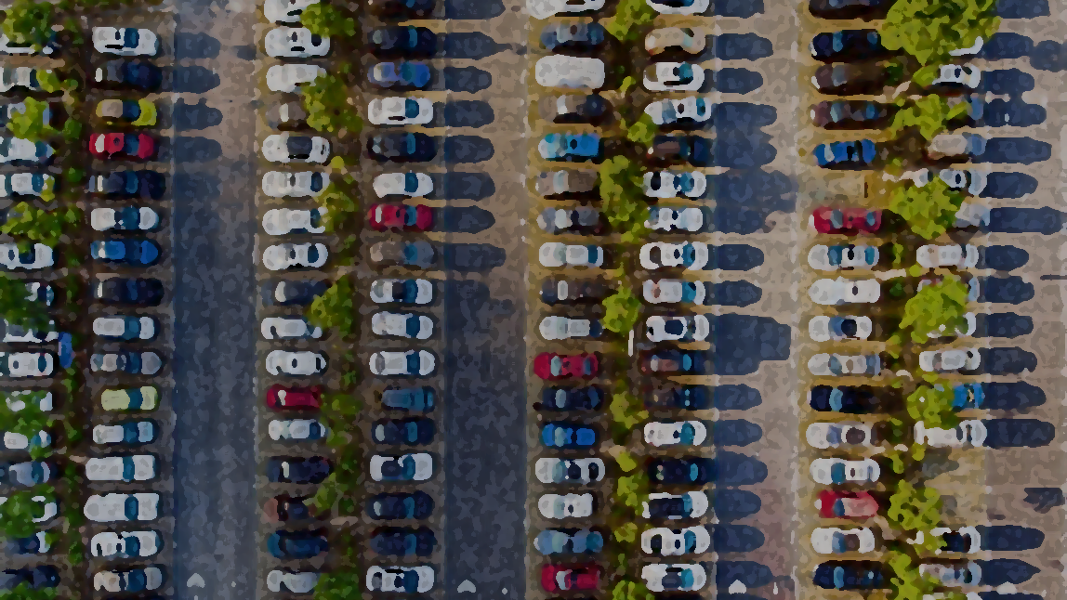
Parking System
By Aadi Umrani

Slide 2

Objective
Develop a functional parking system
Multiple vehicle parking types
Hourly, daily, and monthly charges for each type.
Multiple payment methods
Collect user info
Generate parking sticker
Generate bill
Generate daily, weekly, and monthly reports

Slide 3
Vehicle Types | Parking Spaces |  | Charges | Charges
 |  |  | Initial | Per Hour | Per Day | Per Month (30 days)
 | Normal | Handicapped
2-Wheeler | 9500 | 500 | 5 | 12 | 250 | 5000
4-Wheeler | 2800 | 200 | 17 | 40 | 900 | 25000
Truck | 500 | - | 35 | 80 | 1750 | 40000

Slide 4
Vehicle Types | Parking Spaces |  | Charges | Charges
 |  |  | Initial | Per Hour | Per Day | Per Month (30 days)
 | Normal | Handicapped
2-Wheeler | 9500 | 500 | 5 | 12 | 250 | 5000
4-Wheeler | 2800 | 200 | 17 | 40 | 900 | 25000
Truck | 500 | - | 35 | 80 | 1750 | 40000
2-Wheeler is parked for 3 months, 20 Days, 5 hours, 10 minutes
Total charge: (5000 x 3) + (250 x 20) + (12 x 5) + 5 = 20065

Slide 5
Methods of Payment: Cash Card UPI | User info collected: Vehicle type Vehicle number plate Handicap (Y/N)
Parking sticker contents: Parking sticker ID Parking number Parking type Handicap | Bill contents: Parking type Entry time Exit time Parking Duration Amount to be paid
Records
CSV records
Record the number plate, time of entry, time of exit, duration, and charges
Records are simultaneously entered as the bill is generated
Report contents
Daily, weekly, and monthly collection

Slide 6
Methods of Payment: Cash Card UPI | User info collected: Vehicle type Vehicle number plate Handicap (Y/N)
Parking sticker contents: Parking sticker ID Parking number Parking type Handicap | Bill contents: Parking type Entry time Exit time Parking Duration Amount to be paid
Report contents
Daily, weekly, and monthly collection
Records
CSV records
Record the number plate, time of entry, time of exit, duration, and charges
Records are simultaneously entered as the bill is generated

Slide 7
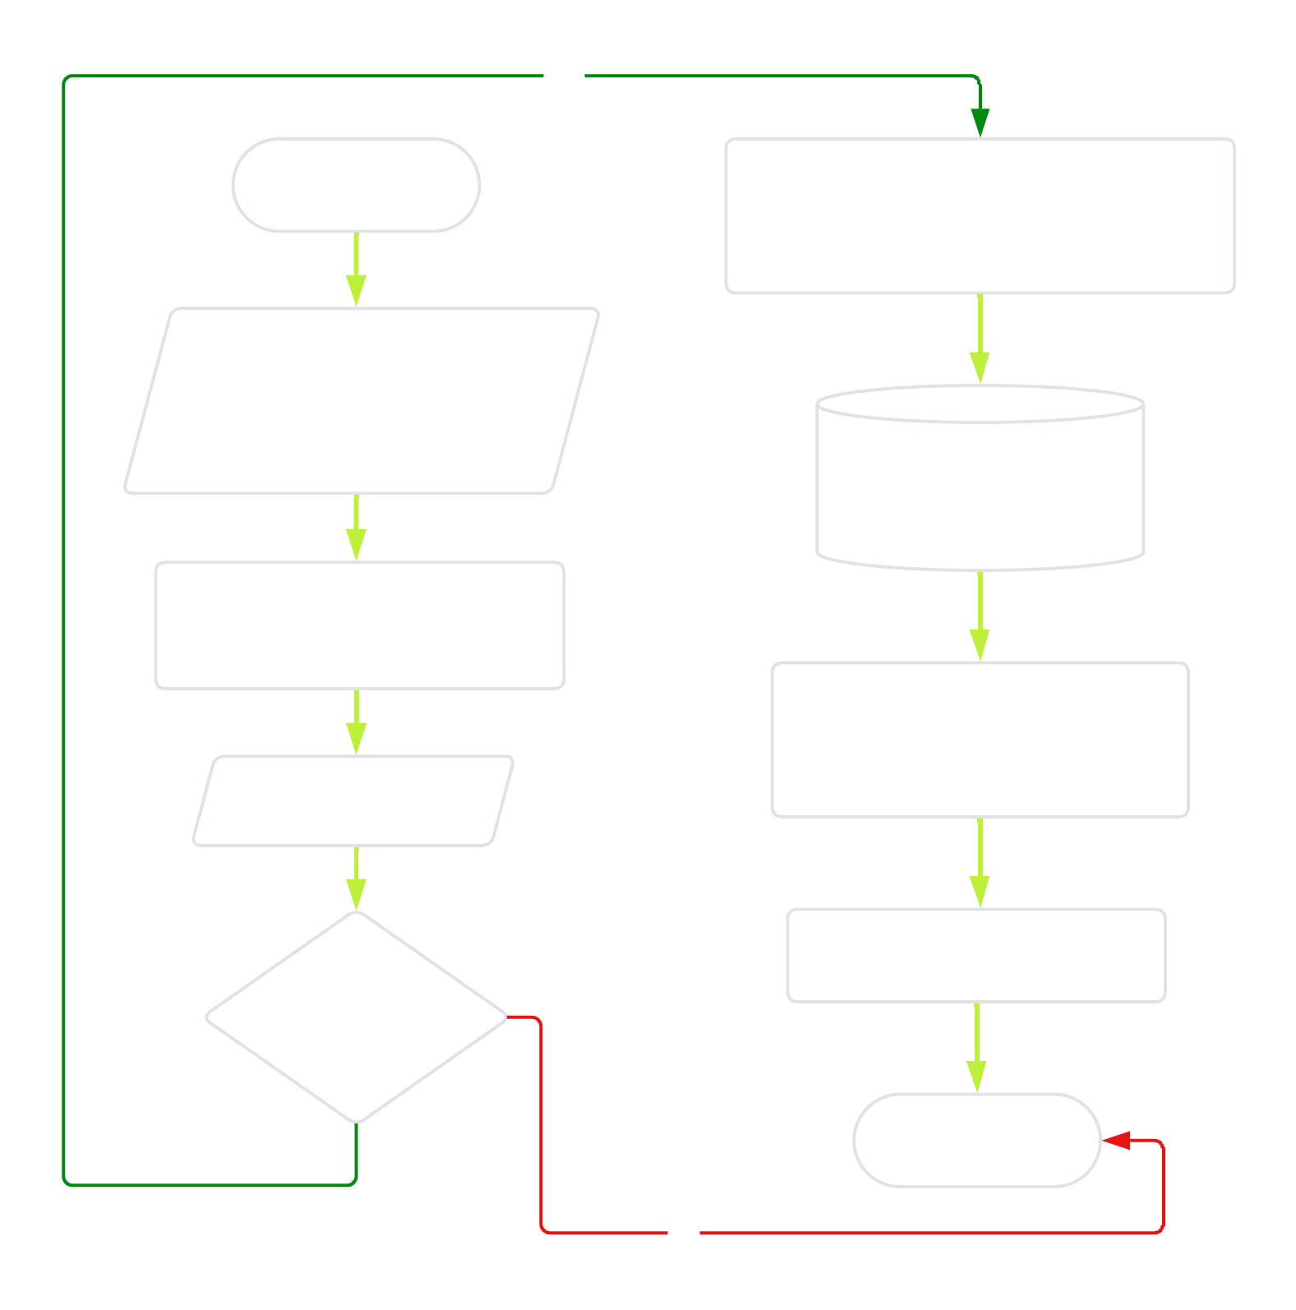
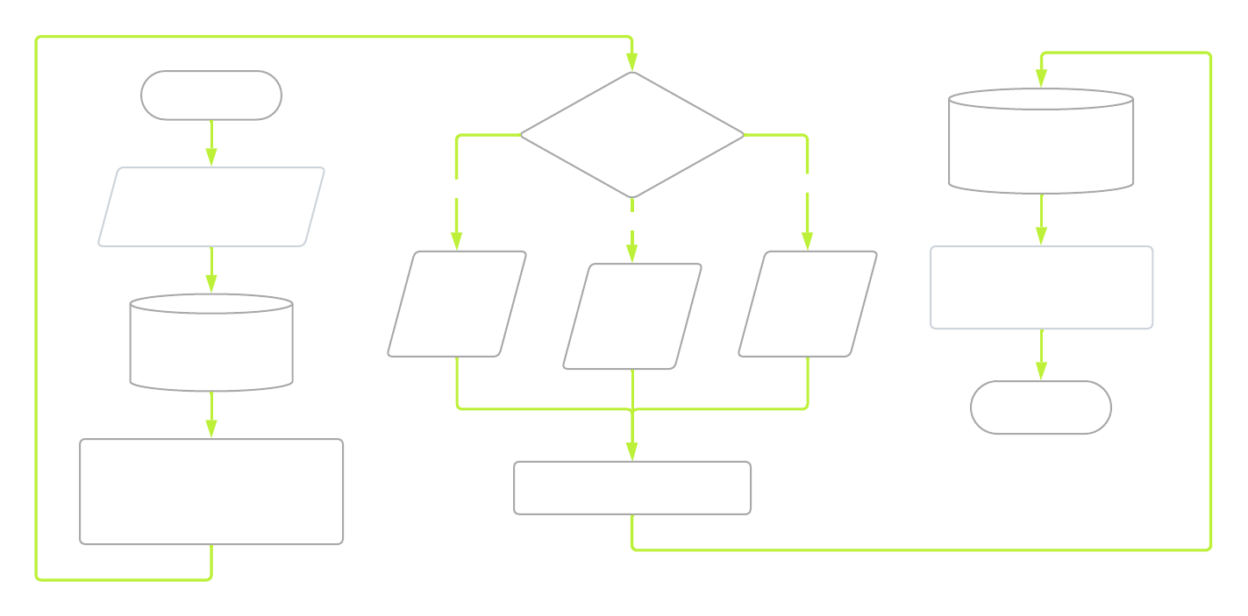
Exit gate flowchart
Entry gate flowchart

Slide 8
Exit gate flowchart
Entry gate flowchart

